Slide 1
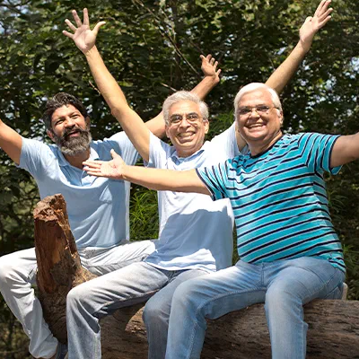
Senior Wellness
ICPM – Capstone Assignment
Author :
Sai Tarun Kovelamudi
Aishwarya Borde
Gladwin Isaac

Slide 2
Agenda
Executive Summary
Customer Journey & Customer Interview
Empathy Map
User Persona
Value Proposition canvas
MVP

Slide 3
Executive summary
Senior Wellness aims to promote a healthy lifestyle and support during
Emergency situation for senior citizens/Aged parents .

Slide 4
Customer Journey & Interviews
Customer Interview Questions (6 people were interviewed in person)
How often do you monitor your health, and what methods do you currently use?
How comfortable are you with using technology, such as smartwatches?
Do you currently have a caregiver, or would you be interested in having one in case of
Emergencies?
4. How frequently do you experience health issues that require medical attention?
5. How important is it for you to have a device that can monitor your health and alert your caregiver
if anything goes wrong?
6. What features do you consider important in a smartwatch that is designed to monitor your health?
7. How would you like to receive alerts in case of emergencies, such as through a phone call, text
message, or push notification on the smartwatch?

Slide 5

Empathy Map
Say
Think
I am an old person who doesn’t have full control over health anymore.
I need to be careful with what I eat because of my diabetes.
I don't have as much energy as I used to.
I wish I could still do some of the things I did when I was younger.
I used to be so active when I was working, but now I feel like I'm stuck at home most of the time. I miss being able to travel and see new places.
I cannot afford a full time care taker.
I think my children are concerned about my health.
I hope my diabetes doesn't get worse.
I miss working and feeling productive.
I want to stay healthy so I can enjoy my retirement.
I wish I had taken better care of myself when I was younger. Maybe I wouldn't be dealing with all of this now.
Does
Feels
I take medication and insulin as prescribed.
I visit the hospital for regular check-ups.
I monitor my blood sugar levels regularly.
I try to stay active by going for walks or doing light exercises.
I spend time with my wife and enjoy quiet activities like reading or watching TV.
I attend diabetes support groups to connect with others who are going through similar experiences.
Sometimes I feel anxious and my blood pressure increases.
I am worried about the future of my health.
I am frustrated about not being able to do everything I used to.
I am afraid of developing complications or losing my independence.
I am grateful for the support of my loved ones, particularly my wife.
I feel I have lost control over my health up to a certain limit.

Slide 6
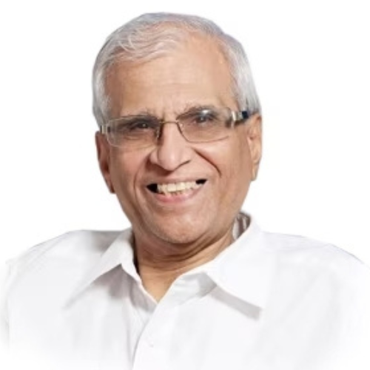
User Persona
Personas: Users of the product are senior citizens and their partners, relatives, caregivers or their children.
Bio: Mr Raja is a 63-year-old retired accountant who lives in a quiet suburban neighbourhood with his wife of 40 years,
he suffers from diabetes. He walks daily and eats healthy. He wants to monitor his health regularly, so he is interested in using a smartwatch, he may want to consider one that is designed specifically for seniors and offers features such as fall detection and emergency alerts.
Pain Points:
Aassistance's in case of emergencies or occasional support as needed.
Keeping a log of blood sugar levels regularly after check-up.
Checking the health parameters regularly by visiting the doctor.

Slide 7
Behaviours
Raja takes a proactive approach to his health by monitoring it closely and seeking regular check-ups with his doctor.
He maintains a healthy lifestyle by eating a balanced diet, exercising regularly, and getting enough sleep.
He tracks his exercise and diet using fitness tracker, to ensure he is meeting his health goals.
Aspirations
To track physical activity and monitor heartrate, BP, Sleep, sugar level & other health parameters.
Utilising wearable technology to monitor health.
Assistance from someone in case of an emergency situations.
Alerting nearby relatives or partner or emergency services during emergency could be lifesaving.

Slide 8
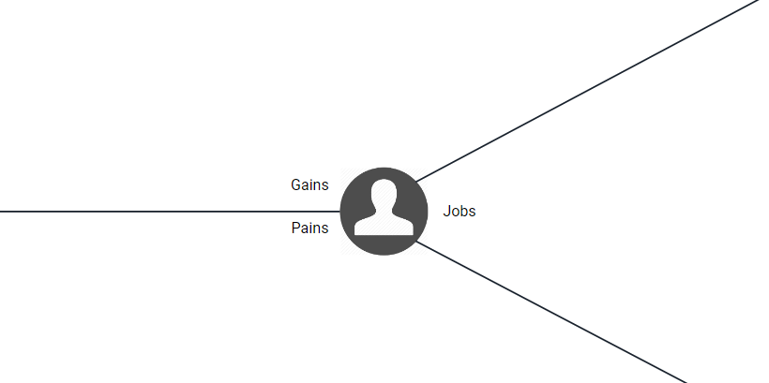
VALUE PROPOSITION CANVAS
Customer Jobs
Functional:
Regular exercise: Raja takes daily walks and practices yoga to stay physically active.
Doctor's visits: He sees his doctor regularly for check-ups and age-appropriate health screenings.
Preventing age-related health issues: prevent age-related health issues through regular health screenings, healthy eating, and regular exercise.
Emotional:
Motivation: Raja feels motivated to take care of his health in order to maintain his independence.
Frustration: He gets frustrated to maintain physical logs of his check-ups.
Social:
Admiration: Neighbour’s and peers admire for dedication to maintaining health and independence and may view as a role model for healthy ageing.
Respect: By taking proactive steps to maintain health, earns the respect of peers and neighbours.
Gains
Improved health outcomes: By tracking health parameters, a user can potentially improve their overall health outcomes.
Cost savings: By identifying potential health concerns early and preventing serious health problems, individuals can save money on healthcare costs.
Enhanced quality of life: The use of a smartwatch integrated with an app can improve quality of life and overall well-being.
Fall detection & alerts: Notifying the fall detection to respective caretaker could be lifesaving.
Digital records: The user can view all the medical records in the app.
Pains
Checking the health parameters regularly by visiting the doctor.
Monitoring blood sugar levels regularly for someone who is diabetic.
Keeping a log of blood sugar levels regularly after check-up.
Aassistance's in case of emergencies or occasional support as needed.
Visiting hospitals for each and every health parameter checkup regularly.
Tracking sleep patterns
In case of an emergency, alerting emergency services or caretaker could be life saving.

Slide 9
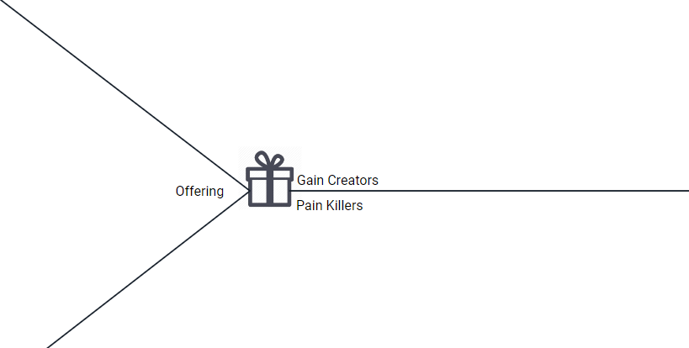
VALUE PROPOSITION CANVAS
Solution: Product features and services
Smart watch + App (Integrated product)
Core Technology: Machine learning, Deep learning, API
Smart watch features:
Tracking heartrate, Tracking Blood pressure, Step count, Tracking ECG, Tracking sleep patterns, fall detection, Emergency alert, Monitor Glucose reading in real-time.
Application (iOS & android) features:
App collects data (heartrate, Bp, ECG & others health parameters as well) from smart watch.
Maintain the logs of heartrate, BP, ECG, sleep patterns, steps count, glucose levels in the app to view by users.
Prediction of unusual activity with the help of machine learning techniques.
Turn on camera automatically during fall detection to capture images and hit app api to send images from smart watch.
Capture images of the place during unconscious time and run those images through computer vision to detect indoor or outdoor environment.
Identify indoor or outdoor environment and show in the app.
Notify caretakers or family or hospital via app or text message or via voice call.
Gain creators
Real-time monitoring: The app can offer real-time monitoring of various health parameters.
Medication management: The app can help individuals manage their medication schedules, ensuring that they take the right medication at the right time.
Early prediction: By monitoring health data over time, the app can identify trends and patterns that may indicate potential health concerns, allowing individuals to seek treatment earlier and potentially avoid more serious health problems.
Greater convenience: Users can easily access their health data and receive notifications or alerts about important health-related events or updates.
Pain relievers
Personalised recommendations: The app can provide personalized recommendations based on the user's health data, such as suggested exercise routines, relaxation techniques.
Medication reminders: The app can also offer medication reminders.
Alerts for abnormal readings: The app can alert users if their health readings indicate a potential health concern or emergency.

Slide 10

MVP – Minimum Viable Product
Hypothesis Statement 1 :
We believe senior citizens
will be using our services
to be cautious and healthy
for emergency lifesaving feature and to maintain good health.
Hypothesis Statement 2 :
We believe working professionals/Children with Aged parents
will be using our services
to monitor and be available
using fall detection feature and other health monitoring features.
Market Risks:
With India as a huge market, already set of companies placed their footprint in the smartwatch segment. Thus it’ll
be a challenge to enter and get the target audience.
Since certain hospitals has its own “Geriatric care” , it’ll be a test to convince the intended users to use our product.

Slide 11
Riskiest Assumptions
As India’s a growing market for smartwatch with 47% year on year growth in 2022 which assumes that there will be huge growth in near future.
With growing India’s Senior citizen’s population, it is to rise by 41% which is 194 million by 2031.Health will become a primary concern as the projected India’s total population around 1500 million.
Can be provided in the competitive cost structure since there are no players with competitive price(Apple SE – INR 30,000 ; Samsung Galaxy watch 4 LTE – INR 29,000).

Slide 12
Thanks !

